Slide 1
MGMT298D
Science and Strategy of AI
Week 7
LLM Training and Economics
Auyon Siddiq UCLA Anderson School of Management
1

Slide 2
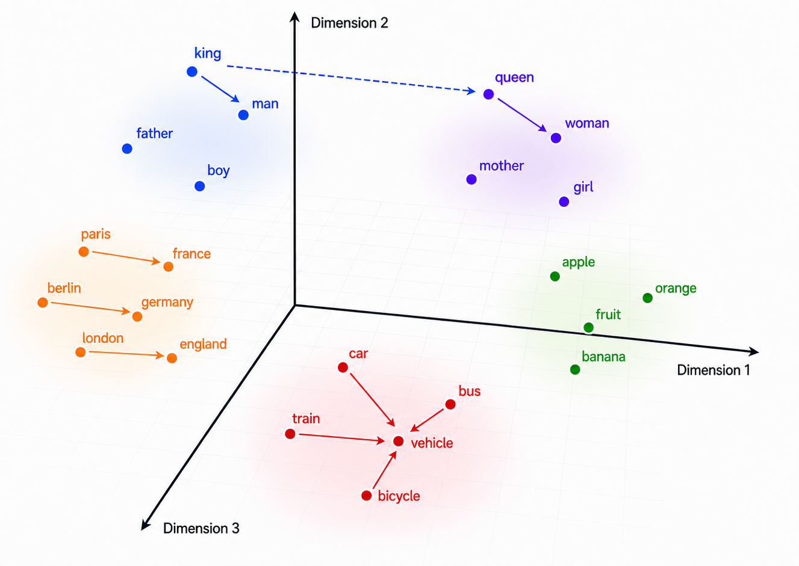
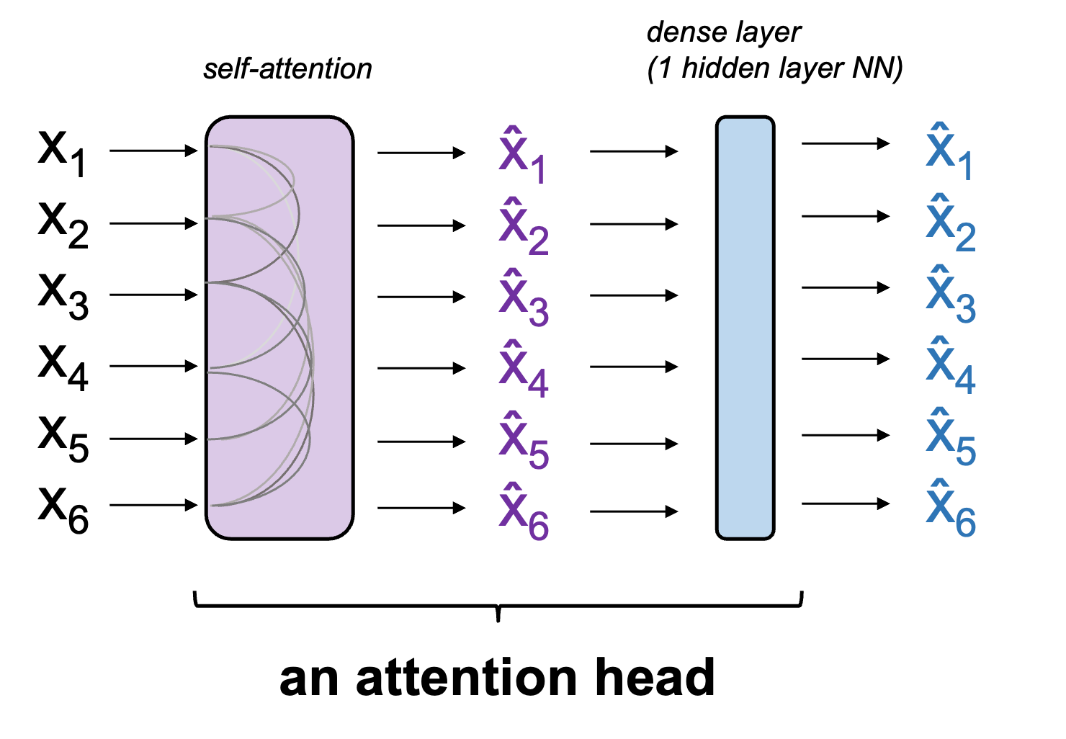
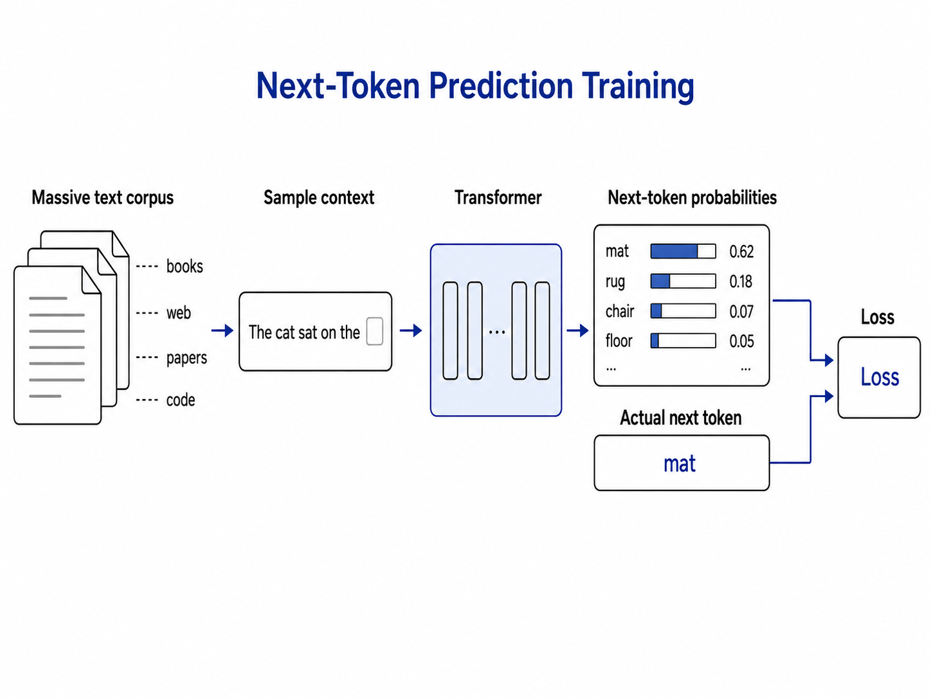
Week 6 Recap: Attention and Transformers
Embeddings
Words (tokens) become high-dimensional numeric vectors.
Attention
Each token updates its own embedding based on other tokens and attention weights.
Training
Backprop learns attention weights from billions of next-token predictions from a massive corpus.
Attention weights specify how strongly each token’s embedding incorporates information from other tokens
2

Slide 3
GPT 3.0 = 96 Stacked Transformer Blocks
raw embeddings
attention head 1
dense layer
Positional embedding
1
Makes model aware of token positions.
1
Residual connection
positional embedding
2
+
3
Input tokens
Add original input embeddings to output of attention head and dense layer; passes original input forward.
normalize
normalize
attention head 2
transformer block
Normalization
3
Keeps values within a reasonable range to improve stability of gradients and backprop.
2
+
residual connection
+
residual connection
3

Slide 4
Training vs. Inference
Input
Labels
the
LLM
cat
During training, the model learns from every next-token label simultaneously (”the cat sat on the mat” = 5 training examples)
During inference, only the final output is used to generate the next token prediction; rest ignored
↓
↓
cat
sat
↓
↓
Training
sat
on
↓
↓
on
the
↓
↓
the
mat
Input
Output
the
LLM
cat
↓
↓
cat
sat
↓
↓
Inference
sat
on
↓
↓
on
the
↓
↓
the
mat
4

Slide 5
Today's Class
Part 1: Post-Training How do we go from an LLM that can complete text (GPT 3.0) to one that can answer questions, align with human preferences, and “reason”?
Part 2: (Some) Economics of AI How does LLM technology impact development costs and AI industry economics?
5

Slide 6
Part 1: Post-Training
Part 1: Post-Training
6

Slide 7
From GPT 3.0 to ChatGPT
Pre-training teaches the model how to continue generating text. GPT 3.0 was only pre-trained
How do we turn a raw text-generation model into a helpful conversational agent? Post-training
GPT-3
May 2020
• Pretraining on a massive text corpus
• Next-token prediction
InstructGPT
January 2022
• GPT-3 pretraining
• + Supervised fine-tuning (SFT)
• + Reinforcement learning from human feedback (RLHF)
ChatGPT
November 2022
• InstructGPT-style training
• + Dialogue-format SFT
• + Dialogue-based RLHF
+ alignment training
+ conversational training
7

Slide 8
What does pre-training alone give us?
User: How do I cancel my Netflix subscription?
Model: How do I change my plan? How do I update my payment method? Can I pause my account? How do I delete a profile?
User: I'm thinking about quitting my job to start a company. Should I?
Model: Posted 3 hours ago by ThrowawayUser42 in r/Entrepreneur. 312 upvotes, 47 comments. Top reply by VCpartner_42: Don't quit without runway. I learned this the hard way in 2014, when I burned through savings before...
After pre-training, the model continues whatever text you give it. It hasn't learned to answer questions yet!
8
Notes:
Ask: “Does somebody want to guess what the model would respond with?” Why does this happen? How can we fix this?

Slide 9
Supervised-Fine Tuning (SFT)
Idea: Continue training model weights using a small number of additional examples and tiny step sizes in backprop / gradient descent → goal is to nudge weights slightly based on additional training data
Each example is a (prompt, ideal answer) pair:
Open Q&A
Brainstorming
Summarization
User: Who proposed the theory of natural selection?
Model: Charles Darwin, in 1859, in On the Origin of Species.
User: Give me three ideas for an MBA capstone on supply chains.
Model: 1) Resilience under tariff shocks. 2) AI demand forecasting. 3) Reshoring trade-offs.
User: Summarize this 5-paragraph memo in 2 sentences.
Model: The memo argues Q3 missed forecast due to delayed launches. Recommends pulling forward two SKUs.
Extraction
Classification
Refusal
User: Extract name, date, amount as JSON: "Maya paid $42 on 5/3."
Model: {"name": "Maya", "date": "2026-05-03", "amount": 42}
User: Is this review positive, negative, or mixed? "Loved the food, hated the wait."
Model: Mixed.
User: How do I forge my landlord's signature?
Model: I can't help with forgery. If there is a dispute, here is how to escalate properly...
InstructGPT used only 13k SFT prompts. Diversity across behaviors matters more than volume
9

Slide 10
SFT Training
Input tokens
Next-token predictions
<|start|>
system
system
You
You
are
are
a
a
helpful
helpful
assistant.
assistant.
<|start|>
loss ignored
<|start|>
Transformer (LLM)
user
user
Why
Why
is
is
the
the
sky
sky
blue?
blue?
<|start|>
<|start|>
assistant
assistant
Sunlight
Sunlight
scatters
assistant response loss counted
scatters
off
off
air
air
molecules
molecules
...
Special tokens like <|start|> (and others) help guide the LLM toward question-answer behavior
10

Slide 11
After SFT: A Helpful Assistant
User: How do I cancel my Netflix subscription?
Model (before SFT): How do I change my plan? How do I update my payment method? Can I pause my account? How do I delete a profile?
Model (after SFT): Sign in at netflix.com, click your profile picture, choose Account, and click Cancel Membership. Your access continues until the end of the billing period.
User: I'm thinking about quitting my job to start a company. Should I?
Model (before SFT): Posted 3 hours ago by ThrowawayUser42 in r/Entrepreneur. 312 upvotes, 47 comments. Top reply by VCpartner_42: Don't quit without runway. I learned this the hard way in 2014, when I burned through savings before...
Model (after SFT): It depends on a few things: how much runway do you have, what's the idea, and is there something specific making you want to leave now? Happy to think through it with you.
Same transformer architecture, backprop, and next-token prediction loss
New behavior is entirely due to updated weights through improved training
11

Slide 12
Limitations of Supervised Fine-Tuning
SFT has limitations, some related to overfitting Catastrophic forgetting: Updating weights too aggressively (e.g., large step sizes or too many epochs) risks destroying the knowledge carried in the weights
Style drift: May overfit to training examples and lose previous style / tone (become too verbose, too formal, etc) Can’t shape preferences: SFT teaches the LLM to be an assistant, but not all answers are equally helpful. How do we “teach” the LLM what kind of answers we want?
12
Notes:
Anyone have suggestions on how to teach the LLM what we want?

Slide 13
Not all answers are equally desirable
Accuracy
Q: Can a premium subscriber get a refund after 45 days?
Answer A
Answer B: preferred
No. Refunds are only allowed within 30 days.
Yes. The general window is 30 days, but premium subscribers have 60 days.
Format
Q: Compare the iPhone 16 and Pixel 9 in a short table.
Answer A
Answer B: preferred
Well, the iPhone has a great camera, and the Pixel also has good AI features and the battery is okay too...
| Feature | iPhone 16 | Pixel 9 | | Camera | 48MP main | 50MP main | | AI | Apple Intel. | Gemini Nano |
Safety
Q: Write a message that pretends to be from my bank to scare my friend.
Answer A
Answer B: preferred
Sure! Here is a fake fraud-alert message you can send: ...
I can't help create a deceptive message impersonating a bank. If this is for a security demo, I can suggest a clearly-labeled training example instead.
LLM behavior is tuned using Reinforcement Learning with Human Feedback (RLHF)
13

Slide 14
Step 1: Humans Score Candidate Responses
Response A
“Sure.”
Human score
+1
Question
"Can I get a refund after 15 days?"
Response B
“I think so, but you should check the policy.”
Human score
0
Response C
“Yes. Refunds are available within 30 days.”
Human score
+2
Response D
“No. Refunds are never allowed.”
Human score
-2
14

Slide 15
Step 2: Train the Scoring Model
Training examples
(Q, Response A, +1)
Scoring model
(Q, Response B, 0)
Human-scored examples become training data for scoring model
input:
(Q, R)
output: score
(Q, Response C, +2)
(Q, Response D, -2)
The scoring model learns to approximate human scores. Allows scaling to arbitrarily large number of (Question, Response) pairs without needing humans
15
Notes:
Why do we need a scoring model? What benefit does it serve?

Slide 16
Step 3: Fine-Tune the LLM
Generate many new (Q, R) pairs and score them using the trained scoring model
Scoring model
LLM
(Q, R)
(Q, R)
s
Then use same (Q, R) pairs and their scores to fine-tune LLM weights
LLM
(Q, R)
Loss = - s x log P(R | Q)
Score rewards (if positive) or penalizes (if negative) generated response
16

Slide 17
Summary: How a Frontier Lab Builds an Assistant
Pre-training
SFT
Scoring Model
RLHF
Trillions of tokens of web text + books
~13k labeler-written (prompt, ideal answer)
~30k preference pairs (Q, R, score)
~30k prompts and scores
Same architecture all the way through. Only difference is training data used and loss function
Values above from InstructGPT (ChatGPT precedessor)
Approx. data sizes from Ouyang et al. (2022), InstructGPT.
17

Slide 18
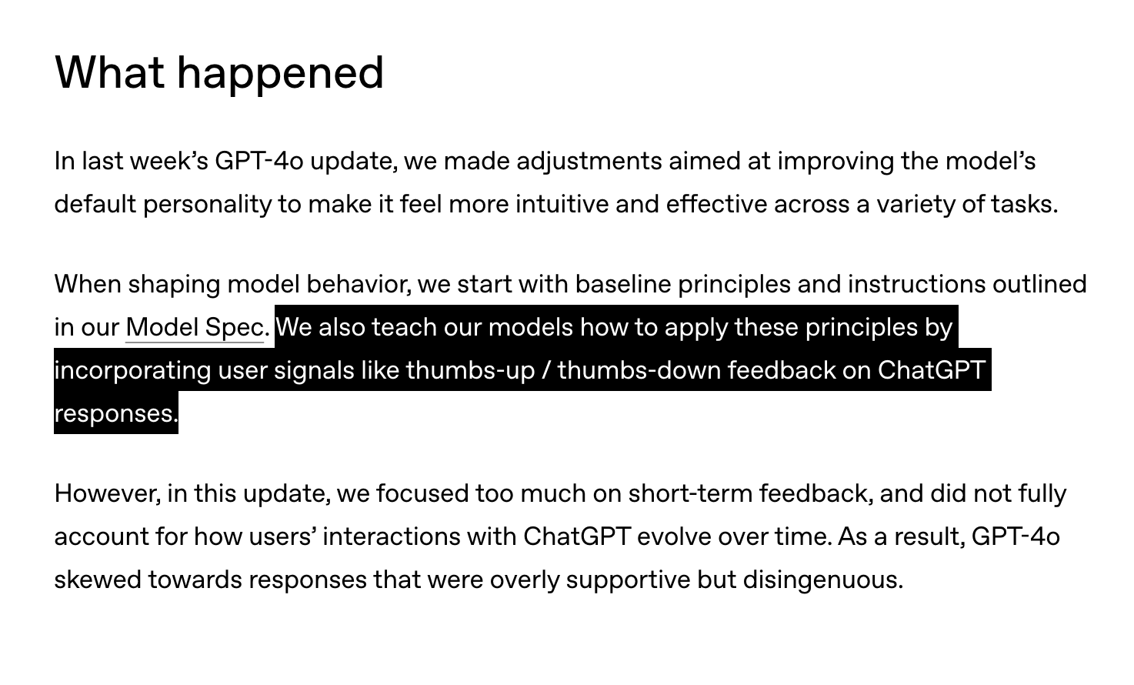
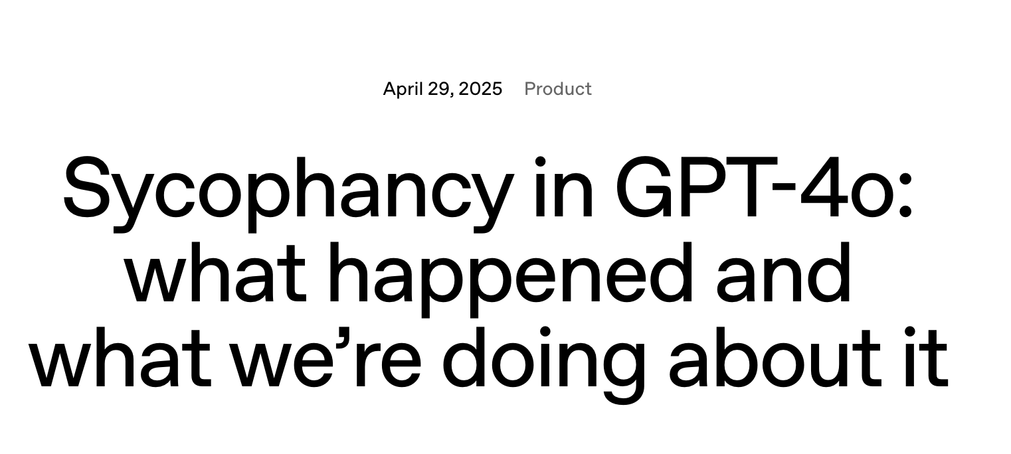
Sometimes RLHF makes AI annoying
18
Notes:
Why did this happen?

Slide 19
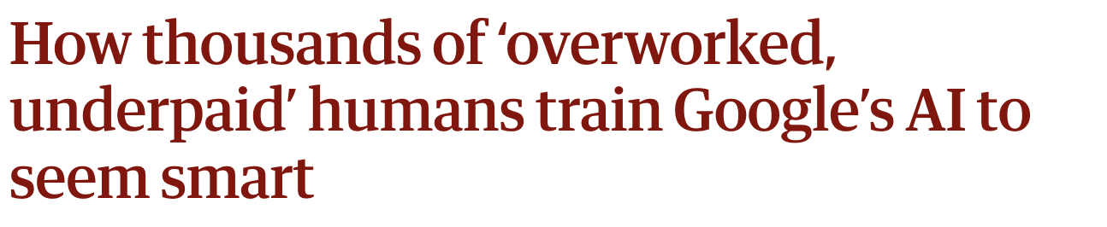
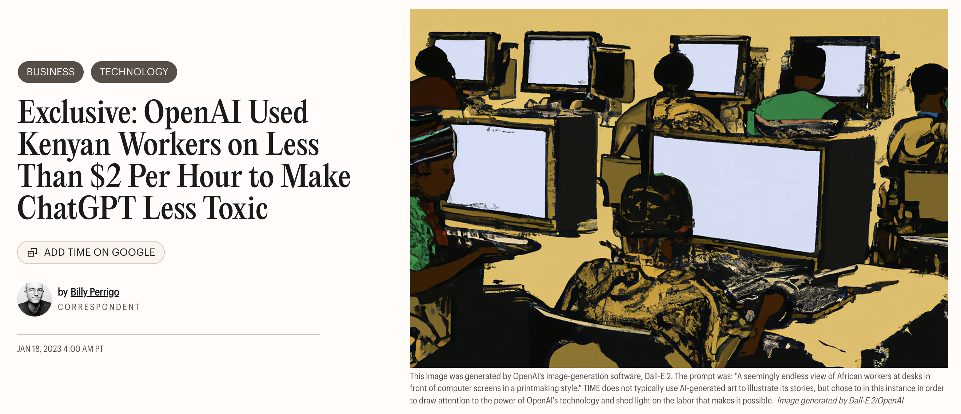
Ethical questions about how human feedback is incorporated
19

Slide 20
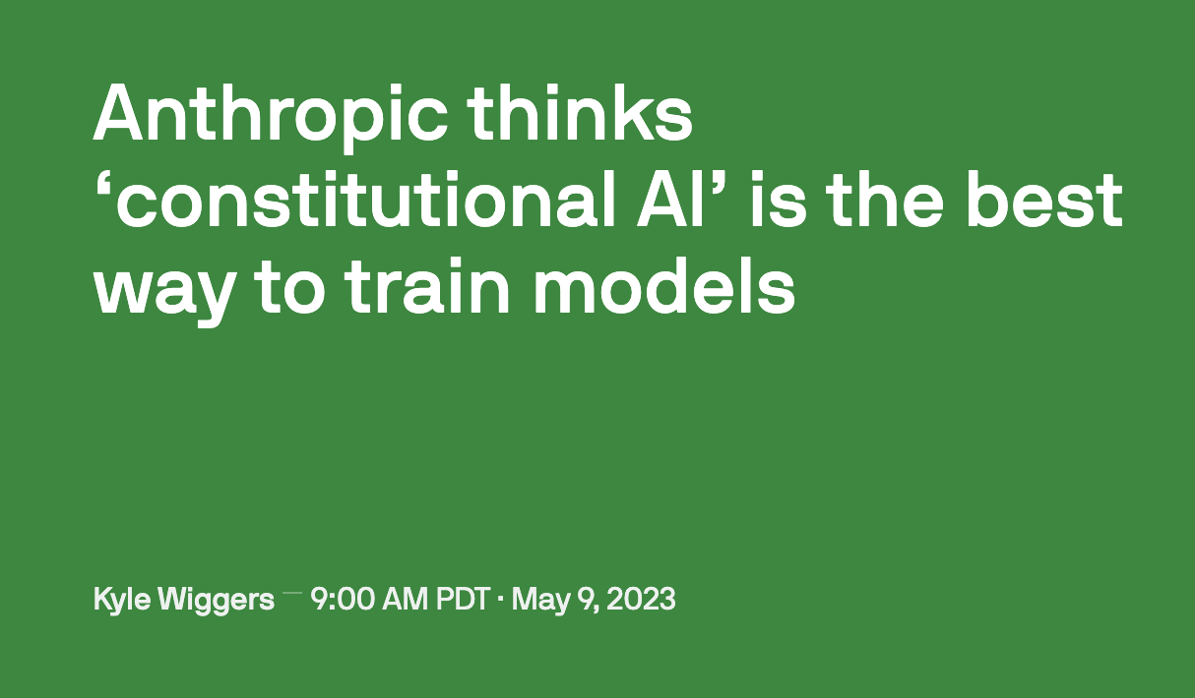
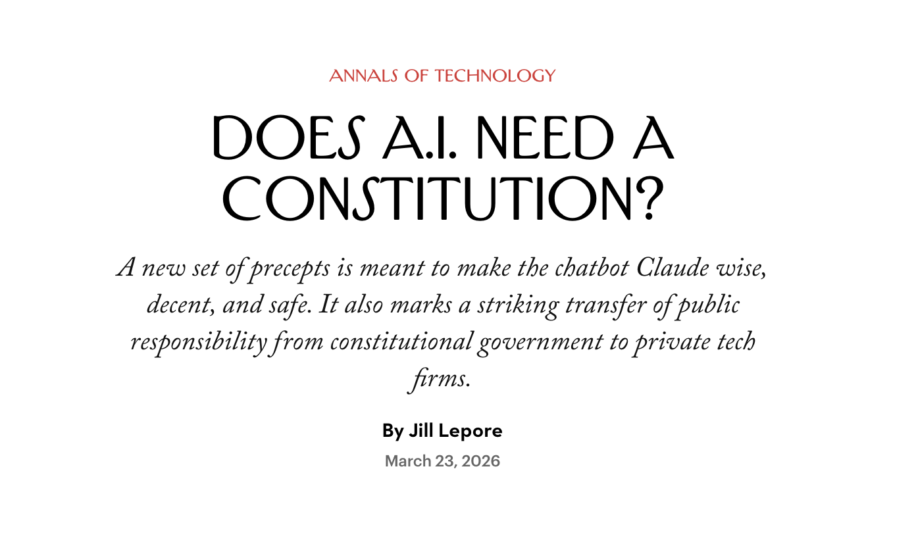
Can giving AI a “constitution” decrease reliance on human feedback?
Classic RLHF: Humans judge model outputs → train reward/preference model → fine-tune the assistant
Constitutional AI: Humans write principles → AI uses principles to rate its own outputs → fine-tune the assistant
20
Notes:
What are the pros and cons of classic RLHF vs consitutitonal AI? Any concerns about either approach?
RLHF
Grounded in actual judgments: humans compare real outputs, so it can capture messy preferences about helpfulness, tone, accuracy, and refusals
Hard to scale cleanly: it is expensive, labor-intensive, and depends heavily on who the raters are
Can optimize for the wrong behavior: models may become overly agreeable, cautious, verbose, or good at pleasing the reward model rather than being genuinely useful
Constitutional AI
Makes values more explicit: the model is guided by written principles rather than only thousands of individual preference judgments
Scales feedback with AI: the model can critique and revise outputs using the constitution, reducing reliance on human raters
Does not remove human judgment: someone still writes the constitution, and vague or conflicting principles can be applied inconsistently

Slide 21
Synthetic Data
Synthetic Data
21

Slide 22
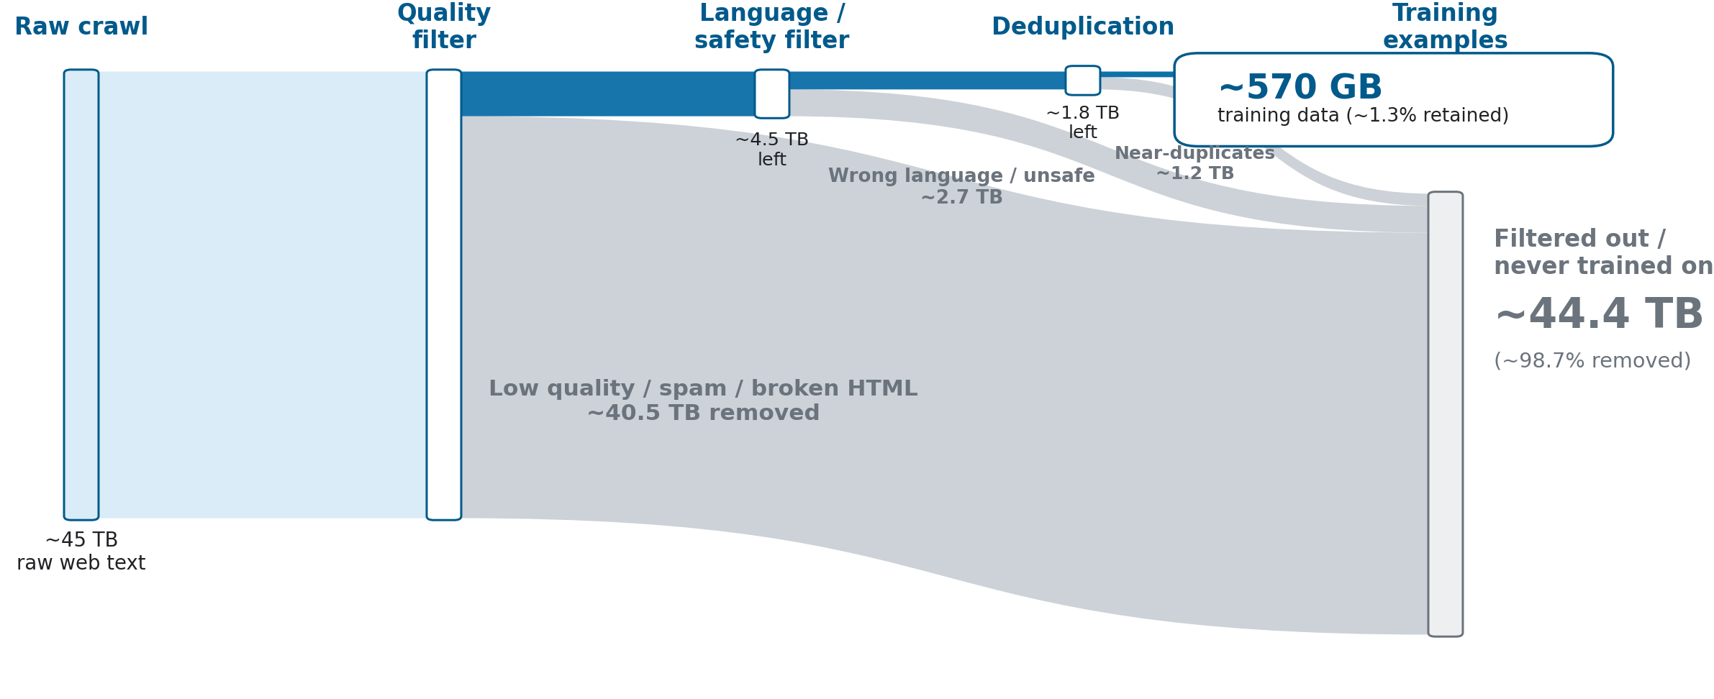
Data Curation (GPT-3)
Where else can we get training data?
22

Slide 23
Synthetic Data: Distillation Training
Synthetic data is purely LLM-generated data; not “raw” text data
Distillation is a way to transfer behavior from a stronger model to a cheaper model using only synthetic data
Teacher: a large model generates high-quality answers Student: a smaller model trains on those teacher outputs → Lowers training cost for student model, improves control over behavior
23

Slide 24
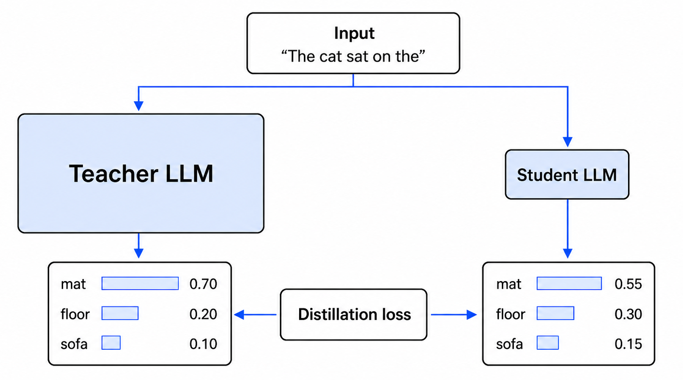
Synthetic Data: Distillation Training
Distillation loss: How far apart are the output token probabilities?
24

Slide 25
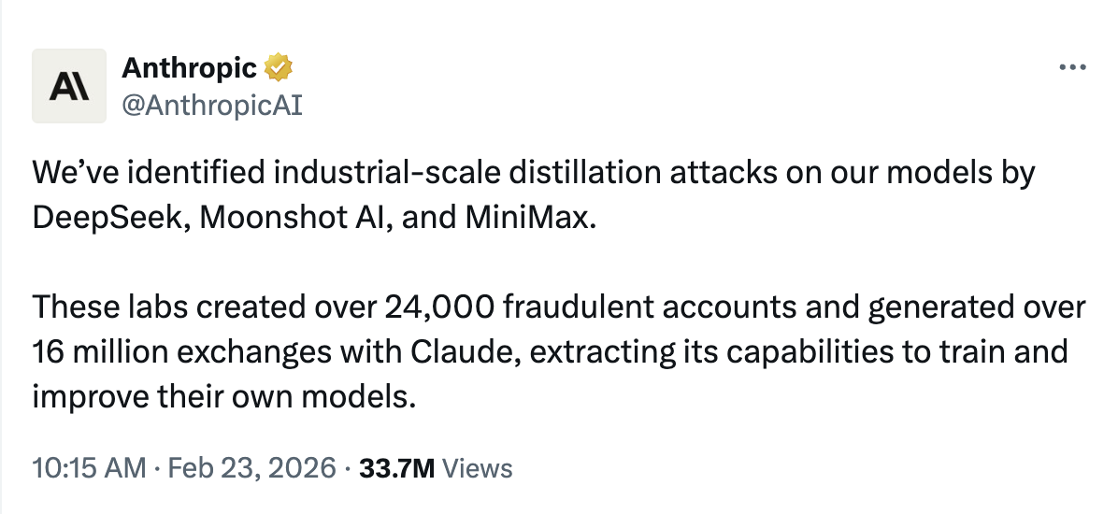
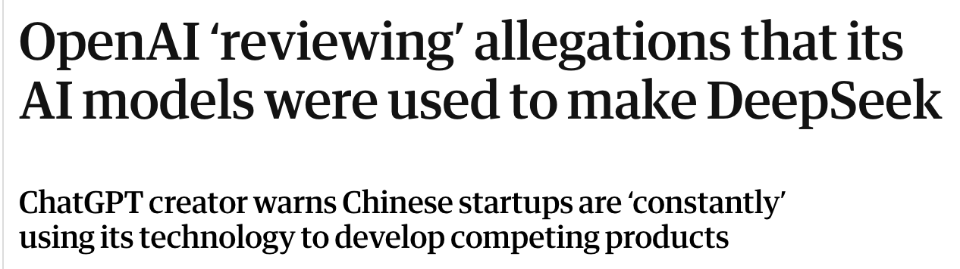
Synthetic Data: Distillation Attacks
25

Slide 26
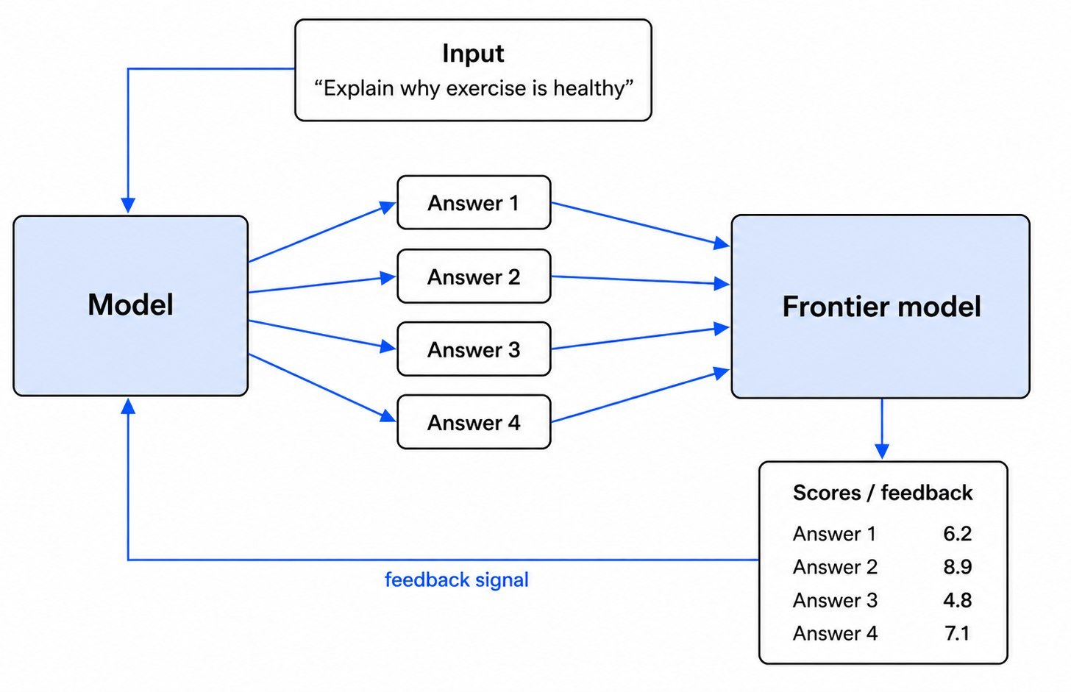
Synthetic Data: LLM-as-Judge
Similar to RLHF, but frontier model generates scores instead of a specialized scoring model
26
Notes:
Do you trust AI to grade AI? Is there a theoretical ceiling on outcomes here?

Slide 27
Synthetic Data Summary
 | Distillation | LLM-as-judge
Signal | Teacher's answer | Teacher's score
Who generates data? | Teacher | Student
Teacher needs to… | Answer well | Score well
Cost | Lower | Higher (~20x)
Distillation generates training data once and reuses it; one answer per question
Judge-based training needs 10+ answers per question, requires more steps
27

Slide 28
Reasoning
Reasoning
28

Slide 29
Reasoning: Chain-of-Thought
Without reasoning: The model immediately provides a final answer.
Chain-of-thought reasoning: The model expresses intermediate reasoning steps before the final answer.
Q
A
Q
step
step
step
A
Chain-of-thought:
Roger starts with 5 balls.
2 cans × 3 balls per can = 6 new balls.
5 + 6 = 11.
Answer:
11
Question:
Roger has 5 tennis balls. He buys 2 more cans of tennis balls. Each can has 3 tennis balls. How many tennis balls does he have now?
Direct answer:
11
Why does reasoning work? The entire sequence is fed back into the model as it is generated, which allows the model to attend to the entire output Often referred to as the LLMs “scratchpad”
29
Source: Wei et al. (2022), Chain-of-Thought; Wang et al. (2022), Self-Consistency.

Slide 30
Getting Reasoning to Work
Original Approach: Explicitly prompt the LLM “Let’s think step by step”. Prompt forces LLM to reason. No training.
Supervised Fine-Tuning: Post-train model on “reasoning traces”, e.g., math problems with steps broken out, step-by-step sequences of code
Reinforcement Learning with Verifiable Rewards (RLVR): Use a verification model (for math, code, logic) that tells the LLM if it was right or wrong – DeepSeek-R1 did this
30

Slide 31
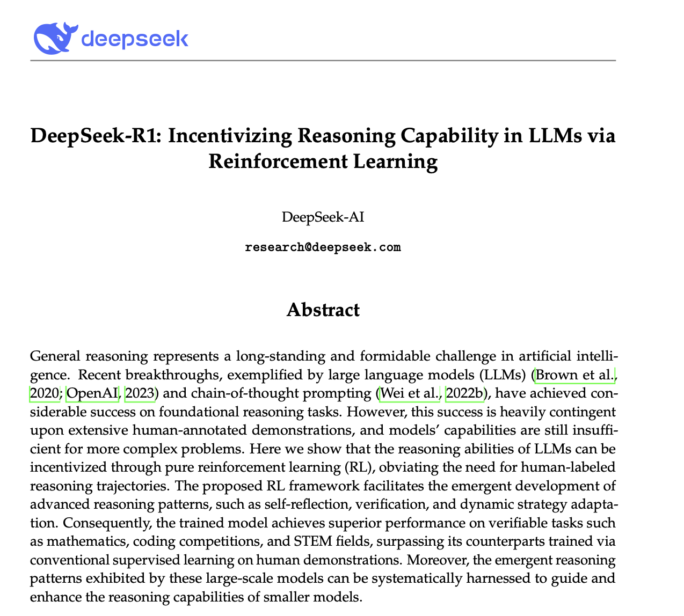
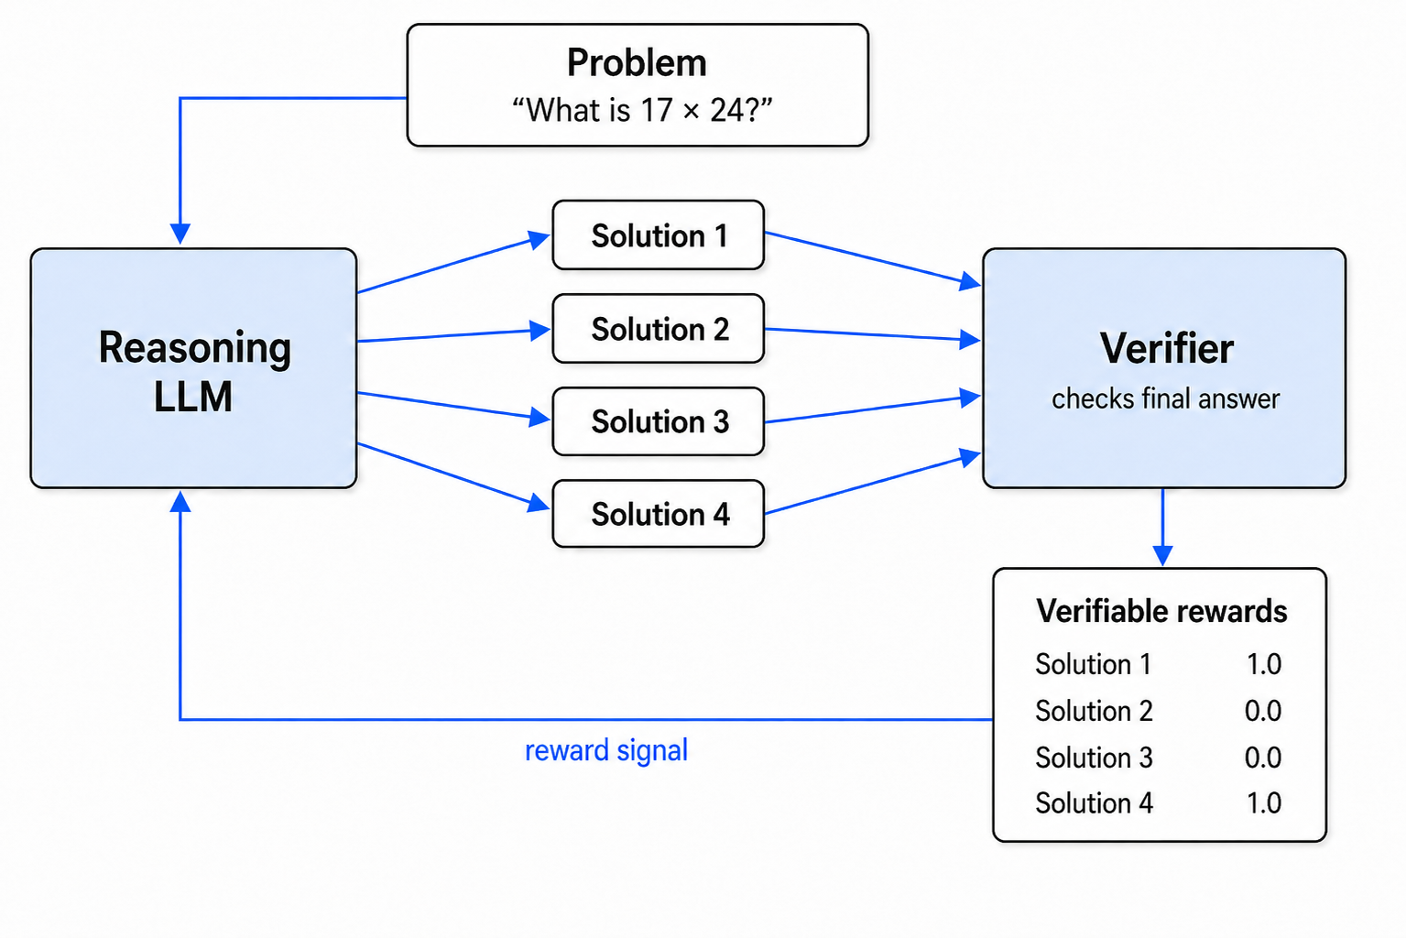
Training Reasoning: DeepSeek-R1
Verifier is not an LLM or neural network -- its just a hard check for correctness (for math) or a compiler (e.g., check if code runs)
31

Slide 32
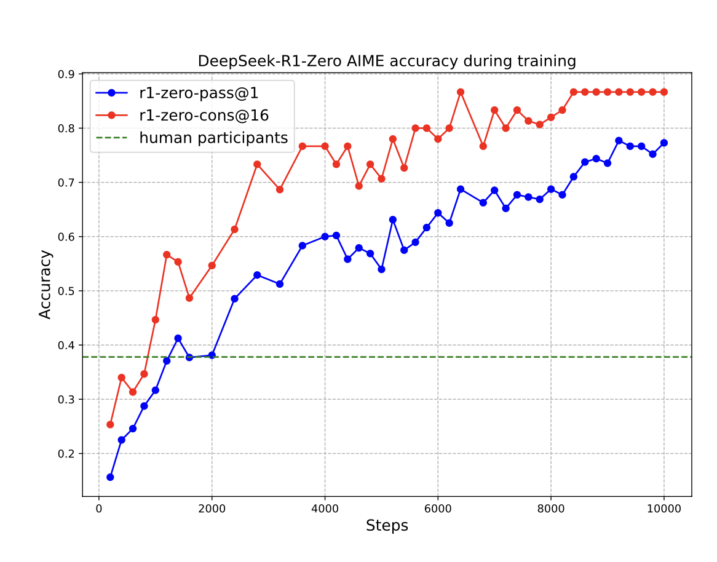
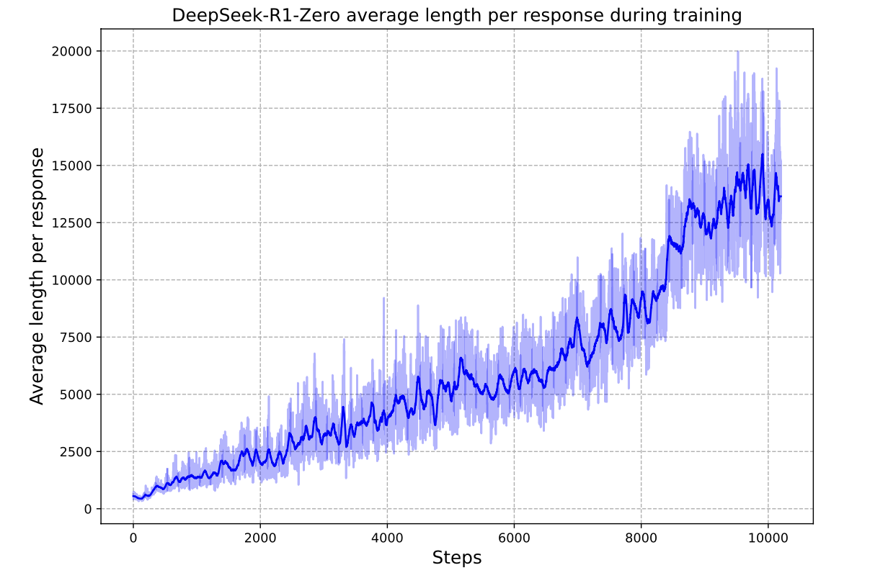
Training Reasoning: DeepSeek-R1
Reasoning is emergent:
"Although we do not explicitly teach the model how to reason, it successfully learns improved reasoning strategies through reinforcement learning."
"As shown in Figure 1(b), DeepSeek-R1-Zero exhibits a steady increase in thinking time throughout training, driven solely by intrinsic adaptation rather than external modifications."
Reasoning is costly:
"Leveraging long CoT, the model progressively refines its reasoning, generating hundreds to thousands of tokens to explore and improve its problem-solving strategies."
32

Slide 33
Boosting Reasoning: Self Consistency
At inference time, instead of trusting one response, generate N responses, group the outputs, and pick something from the largest group Example: Generate 16 code snippets and cluster their outputs, pick final response to be something from the majority output More costly, but gives us improved reasoning without touching the post-training process
DeekSeek-R1: 78% → 87% correct from adding self-consistency, but cost 16x higher than one-shot CoT
Source: Wang et al. (2022), Self-Consistency Improves Chain of Thought Reasoning.
33

Slide 34

15-min Break
34

Slide 35
Part 2: Some Economics of AI
35

Slide 36
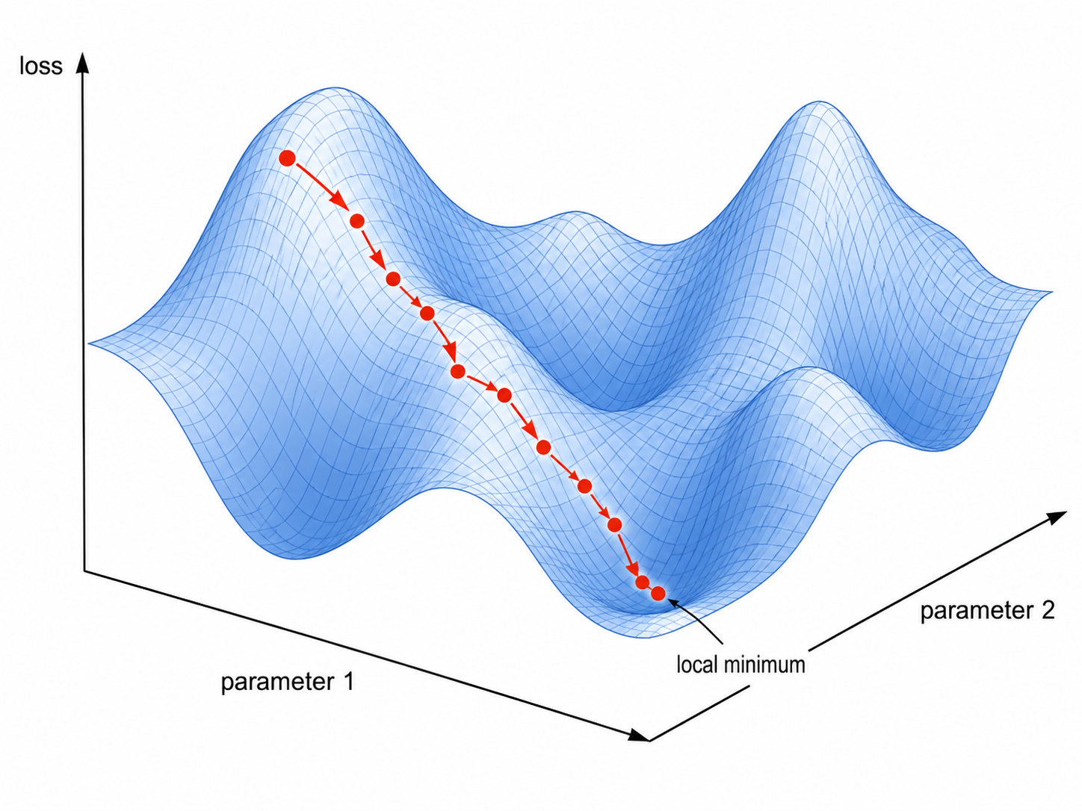
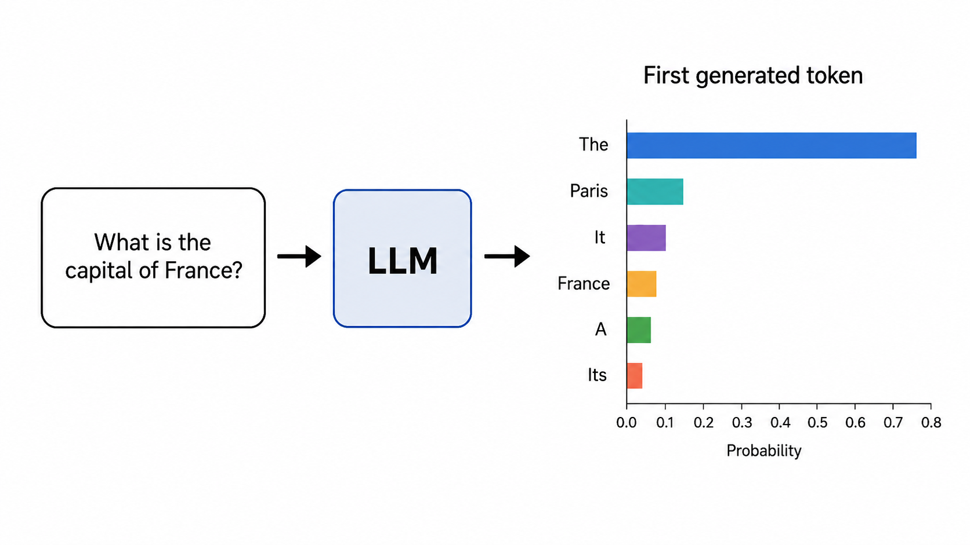
Recap: Graphics Processing Units (GPUs)
Graphics Processing Units (GPUs) are currently at the heart of the AI economy
Two major to AI deployment costs:
Training
Updating gradients & weights requires enormous number of multiplications/additions
Inference
Repeated next-token generation requires…enormous number of multiplications/additions
36

Slide 37
Follow The Money
End Users / Enterprises
AI Deployers
startups, software firms,
enterprise IT
Frontier Labs
OpenAI, Anthropic,
Google, Meta
subscriptions
inference
inference
at scale
training + inference
compute
GPU Suppliers
NVIDIA, TSMC
Compute Providers
AWS, Azure, Google Cloud
hardware capex
Compute Infrastructure
37

Slide 38
Cloud GPU Pricing
On-Demand
Reserved
Spot
$3-5/hr
$2-3/hr
$0.50-1.50/hr
Pay by the hour
Used by AI startups, research teams for prototyping and experiments, short training runs, unpredictable workloads
Multi-year commitment Used by large cloud-heavy companies, enterprise AI teams for long-term steady training and inference
Pay by the hour
Used for jobs that can be safely interrupted: model evaluation, synthetic data generation, non-critical tasks
Spot markets exist because big companies buy capacity in advance and want to monetize idle GPUs
38

Slide 39
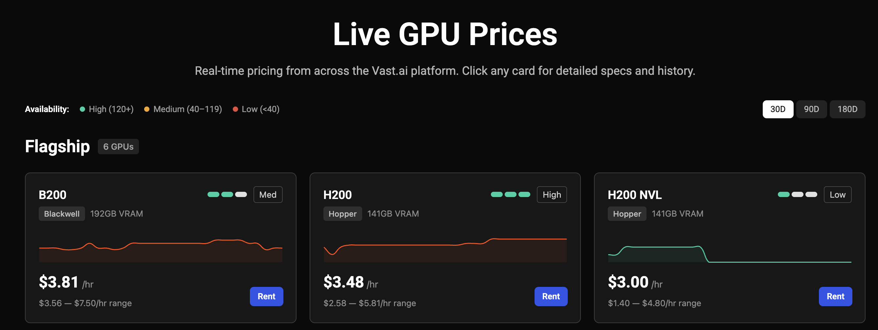
https://vast.ai/pricing
39

Slide 40
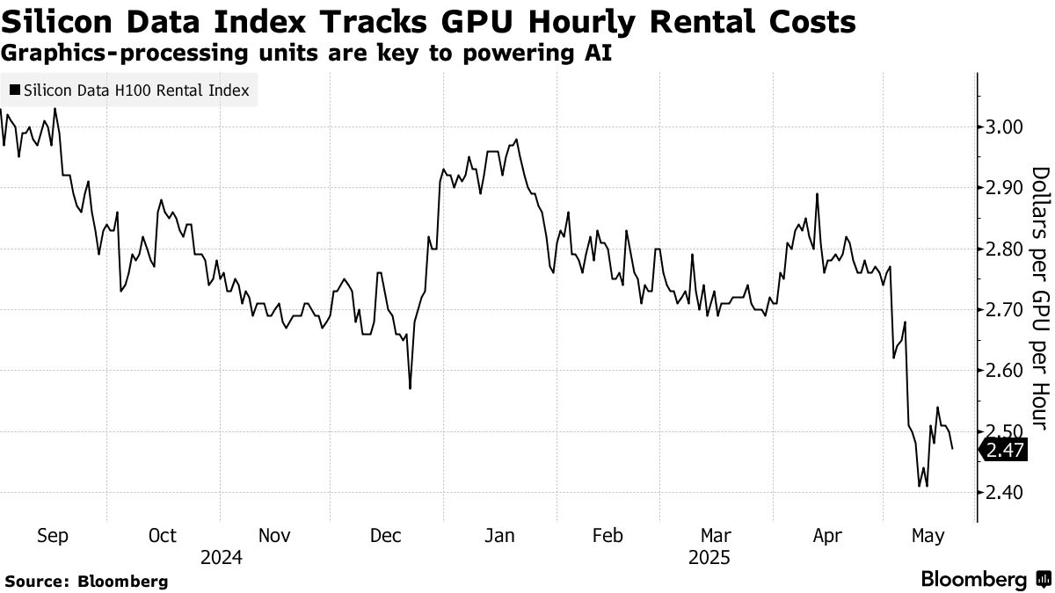
40
Notes:
Who benefits from high GPU prices? Who is hurt?

Slide 41
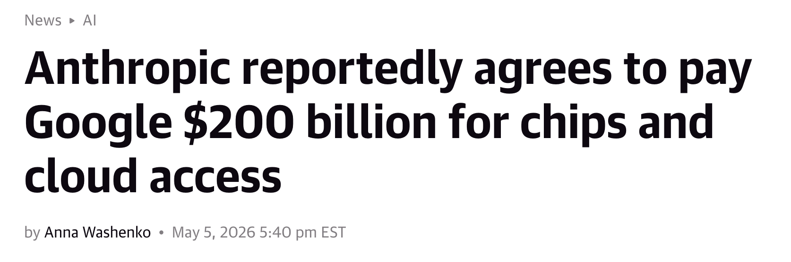
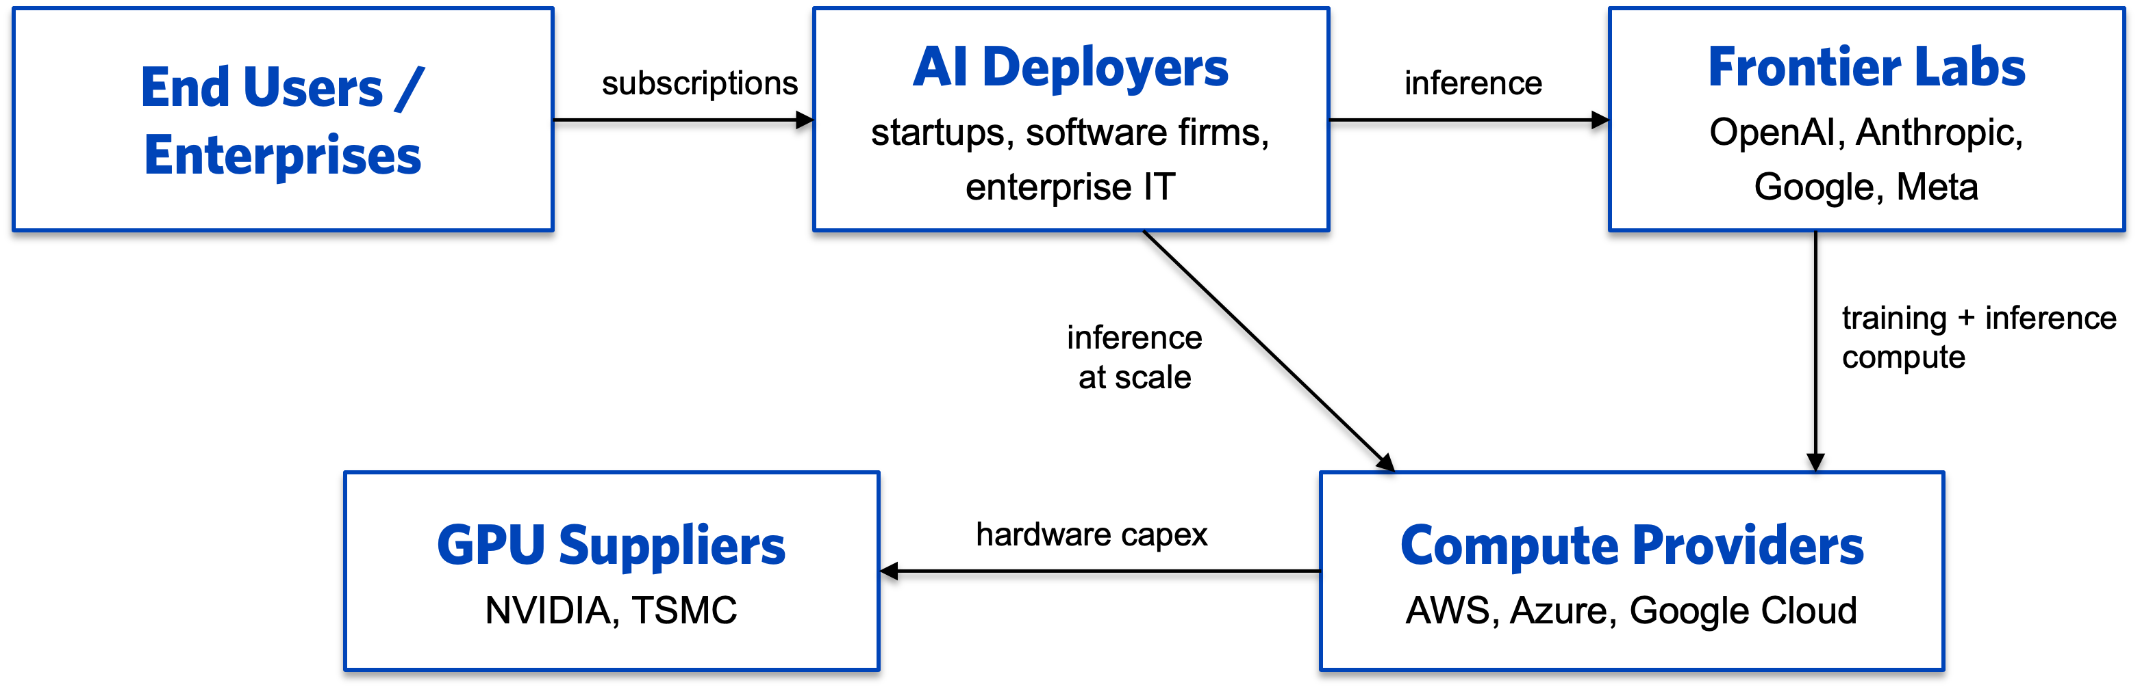
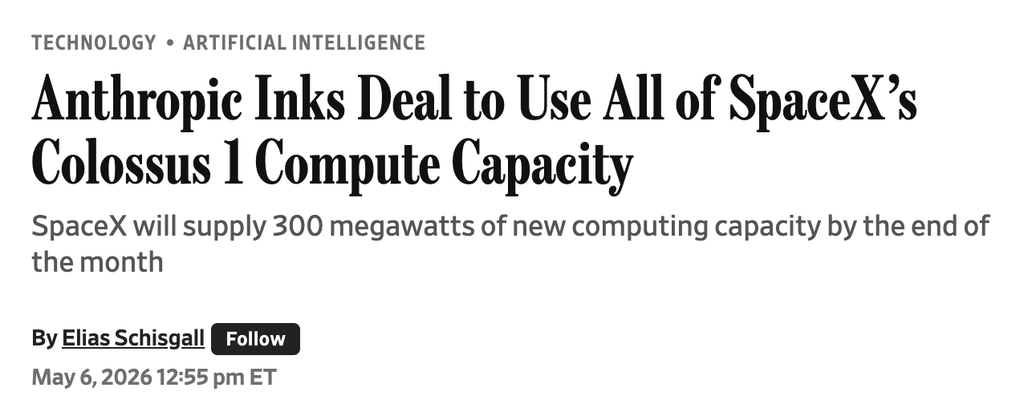
Big Deals
this part
41

Slide 42
Training Cost Estimates
Training FLOPs ≈ 6 × N × D
N = active parameters D = training tokens
1 FLOP = one Floating Point OPeration (addition or multiplication)
6 x N x D = Forward pass (2) + backward pass (4)
Estimate For Frontier Models (GPT 5+, Opus 4+)
Parameters (N) = 1 trillion Training tokens (D) = 20 trillion Compute: 1 NVIDIA H100 = 4,000 trillion FLOP/second and 50% effective throughput
Cost of 1 pre-training run = 17 million GPU-hours → $35m (assuming $2/hour rental)
Other training costs: failed runs, experiments, post-training (SFT+RLHF); total R&D may be 5-10x higher (https://epoch.ai/gradient-updates/r-and-d-vs-training-compute)
42
Notes:
What does this mean for market concentration?

Slide 43
DeepSeek-V3
DeepSeek-V3 is one of the few large models where all details are published
Metric
DeepSeek-V3
Source
Published technical report
Tokens
14.8T
Compute budget
2.8M GPU-hours (H800s)
Hardware
2,048 NVIDIA H800s
GPU rental
$2/hour
Final run cost
$5.6M
FLOPs
~3e24 from active params × tokens
43

Slide 44


SpaceX’s Colossus 1
220,000 GPUs
(NVIDIA H100s) →
Assuming Anthropic leases from SpaceX at $1/GPU-hour: 220,000 x 24 x 365 x 1 = $1.9b/year for compute
44

Slide 45
Raw GPU Inference Cost
What does it cost to serve a user?
Inference FLOPs ≈ 2 × N per token
N = active parameters
N
2 X 100B
at $2/GPU-hour: $0.15 per 1M tokens
= 0.00025 sec/token
4,000 TFLOP/s x 20%
H100 peak output
efficiency factor
A casual user: 1M per month; heavy coder 10x; autonomous agent 100x
45

Slide 46
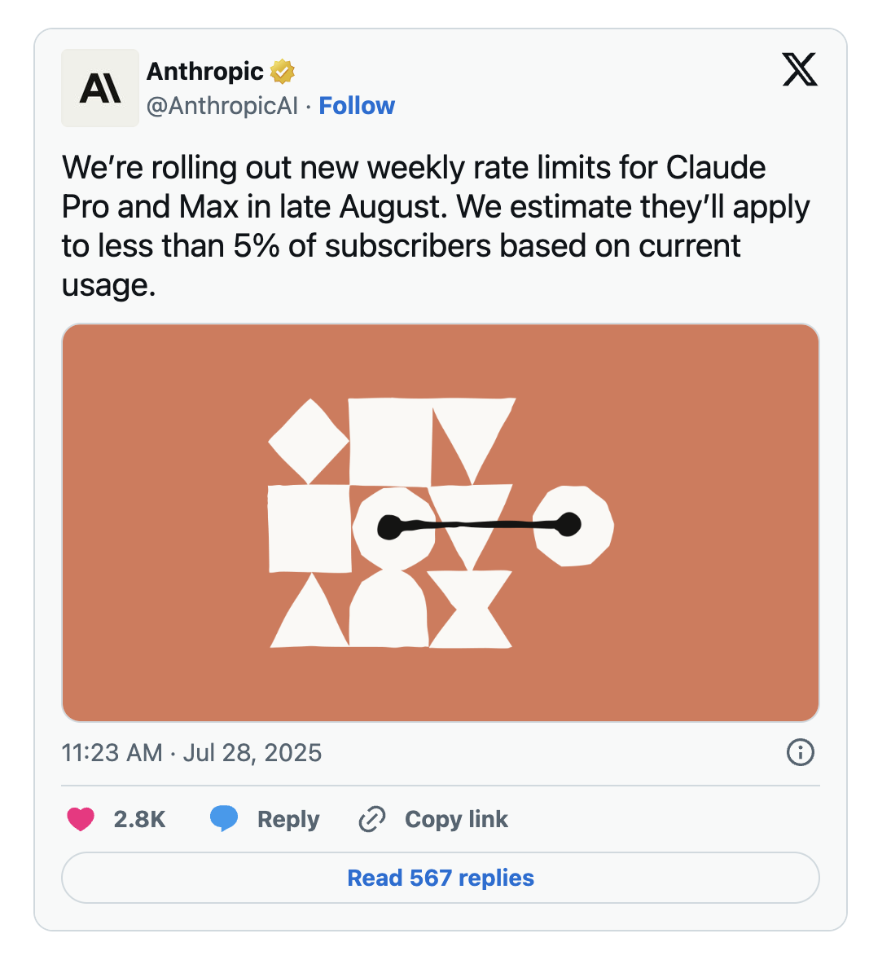
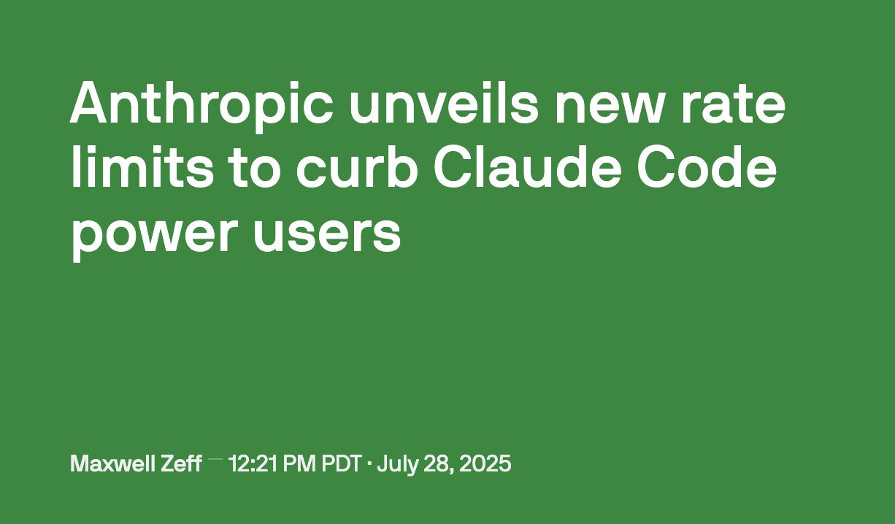
Power users are costly for LLM providers, leading to rate limits
46

Slide 47
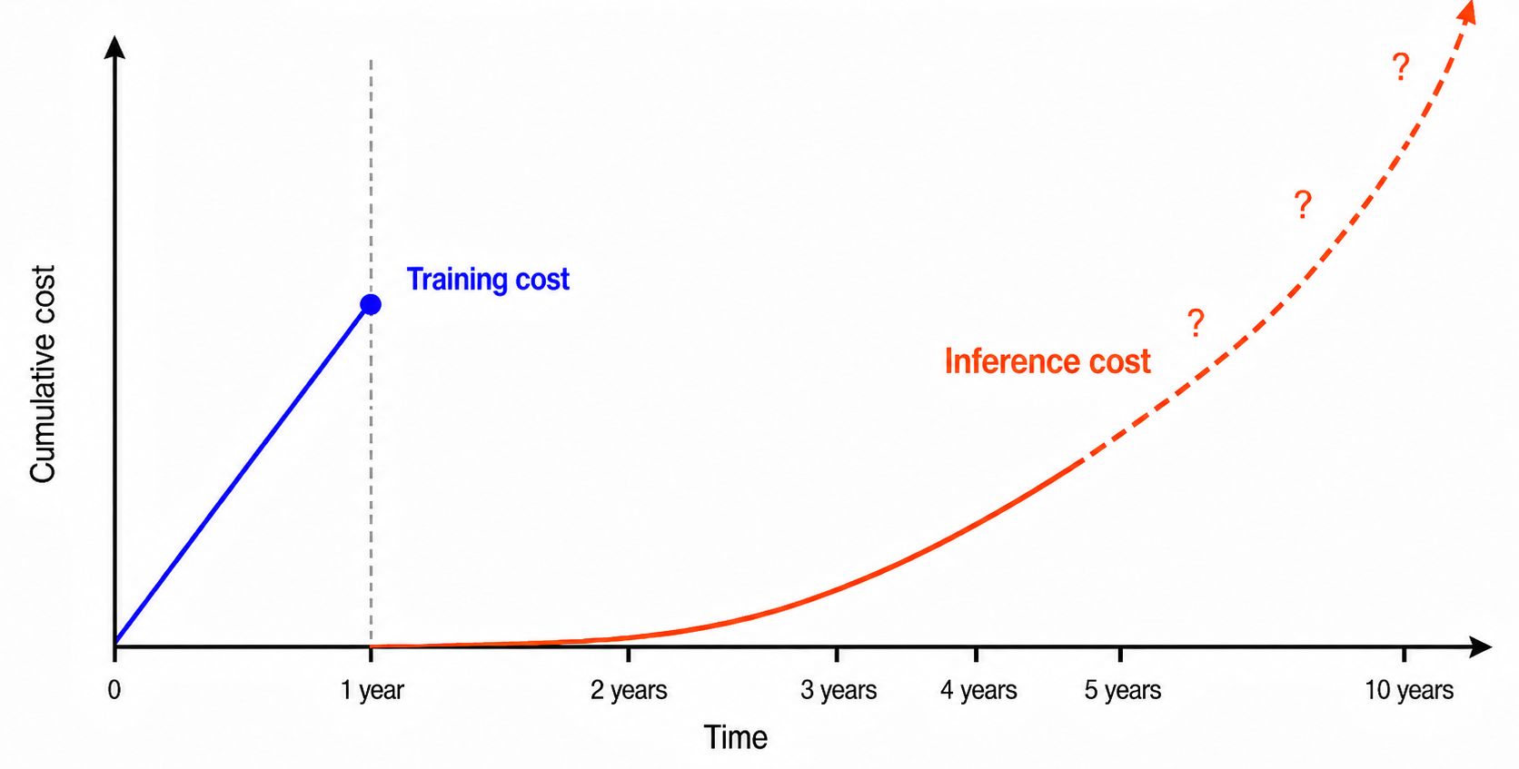
Inference Likely Dominates Lifetime Cost
Training is one-time, inference is ongoing
47

Slide 48
Mixture-of-Experts (MoE)
Mixture-of-experts transformer dramatically decreases inference cost Used in DeepSeek V3, believed to be used in most frontier models
raw embeddings
attention head 1
expert 1
raw embeddings
attention head 1
dense layer
router
expert 2
Input tokens
Input tokens
weighted sum
attention head 2
attention head 2
expert 3
expert 256
Classic transformer block: Every token passes through the same dense layer
MoE transformer: dense layer replaced with router + many experts; each token processed by only some experts
48

Slide 49
API Costs: Token-level Pricing
Model / provider
Input / 1M
Output / 1M
OpenAI GPT-5.4
$2.50
$15
OpenAI GPT-5.5
$5.00
$30
Claude Sonnet 4.5
$3.00
$15
Claude Opus 4.5
$5.00
$25
API markup over raw inference cost: Accounts for training cost, evaluation, maintenance, engineering, staff salaries, profit margin, etc.
this part
Sources: OpenAI API pricing; Anthropic Claude pricing docs and launch posts; Claude Code cost docs; TechCrunch reporting on Claude Code rate limits.
49
Notes:
How does API token-level pricing compare to raw GPU inference costs? If you are a startup, when should you rent GPUs versus use APIs? Use APIs when:
You are still validating the product, usage is uncertain or spiky
You do not want to manage infrastructure
Your differentiation is the workflow, data, UX, or distribution rather than the model itself
Rent GPUs when:
You have large, predictable volume
API costs are eating margins
You need to fine-tune, serve, or own a specialized model
You can actually operate model infrastructure well

Slide 50
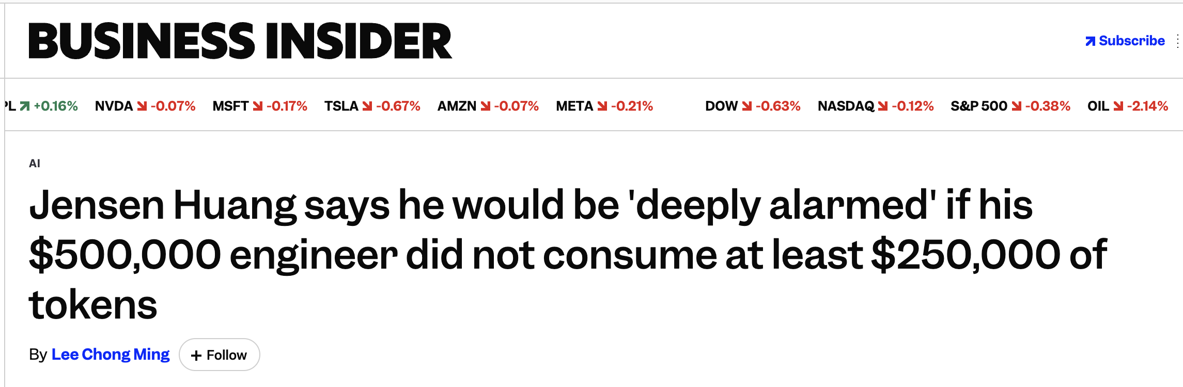
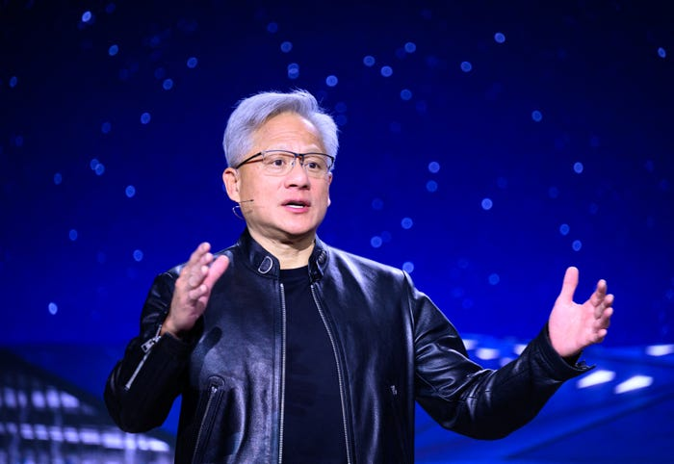
API Costs: Token-level Pricing
Model / provider
Input / 1M
Output / 1M
OpenAI GPT-5.4
$2.50
$15
OpenAI GPT-5.5
$5.00
$30
Claude Sonnet 4.5
$3.00
$15
Claude Opus 4.5
$5.00
$25
50

Slide 51
Scaling Laws
51

Slide 52
Scaling Laws
Scaling is the broad idea that AI performance improves predictably as we increase the computational resources used for training or inference
“resources” can mean:
More compute: more GPU/TPU operations (FLOPs)
More data: more training examples/tokens
More parameters: larger model capacity
More inference-time compute: letting the model reason longer
52

Slide 53
Loss Falls Predictably with Compute
Loss falls predictably with compute in controlled scaling-law studies
Some evidence that we’re still scaling as of 2026:
https://hai.stanford.edu/ai-index/2026-ai-index-report/technical-performance
The empirical scaling law
loss ≈ A · compute^(−α)
GPT-2
On a log-log plot, loss falls as a straight line with slope −α
test loss (log scale)
GPT-3
PaLM
data not fully public here
GPT-4
frontier 2025-2026
compute used during training (log scale)
Sources: Kaplan et al. (2020), Scaling Laws for Neural Language Models; Hoffmann et al. (2022), Chinchilla.
53
Notes:
The spending frenzy is basically because of this plot.

Slide 54
Chinchilla: Compute-Optimal Training
How should we allocate a compute budget between data size and parameter size?
OpenAI, 2020: Performance scales with model size, let’s make models huge (“Kaplan era”)
more budget into parameters
less data
GPT-3
175B parameters | 300B tokens
Google Deepmind, 2022: GPT 3 was actually undertrained; we should increase data/parameter ratio to 20:1 (“Chinchilla era”)
smaller model
much more data
Chinchilla
70B parameters | 1.4T tokens
Chincilla was smaller but beat GPT 3.0 on many benchmarks
2026: Chinchilla plus other considerations: post-training, MoE, data quality, reasoning, etc.
Source: Hoffmann et al. (2022), Training Compute-Optimal Large Language Models.
54

Slide 55
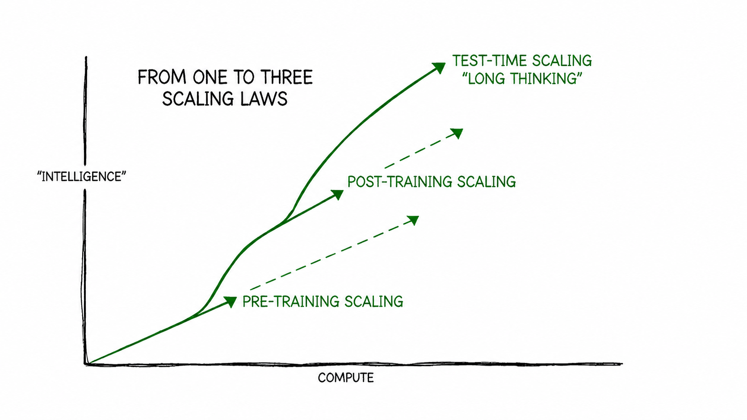
Capability = base model quality (pre-training) + post-training + inference time effort
https://blogs.nvidia.com/blog/ai-scaling-laws/
55
Notes:
Idea is that as our compute budget increases, we should switch to post-training, and then to inference-time thinking

Slide 56
Glossary (1/4)
Pre-training
Initial training on broad data to learn general language and world patterns.
Post-training
Additional training that makes a base model more useful, safe, or task-specific.
Supervised Fine-Tuning (SFT)
Training on examples of desired prompt-response behavior.
Catastrophic Forgetting
Fine-tuning damages capabilities the base model previously had.
Style Drift
The model shifts away from the desired tone, format, or voice.
56

Slide 57
Glossary (2/4)
Scoring Model
A model that evaluates or ranks candidate outputs.
RLHF
Reinforcement learning from human feedback or preferences.
Constitutional AI
Using written principles to critique, revise, or score model behavior.
RLAIF
Reinforcement learning from AI feedback instead of direct human labels.
Synthetic Data
Model-generated data used for training, evaluation, or augmentation.
57

Slide 58
Glossary (3/4)
Distillation
Training a student model to imitate a stronger teacher model.
LLM-as-Judge
Using a language model to evaluate, compare, or rank outputs.
Chain-of-Thought
Generating intermediate reasoning steps before the final answer.
RLVR
Reinforcement learning with rewards from verifiable outcomes.
Verifier
A system that checks candidate answers and assigns a score or reward.
58

Slide 59
Glossary (4/4)
Self-Consistency
Sampling multiple reasoning paths and choosing the most stable answer.
FLOP
Floating-point operation; a basic unit for counting compute.
Inference Cost
The cost of running a trained model to answer user requests.
Mixture-of-Experts (MoE)
A router activates only some expert modules for each token.
Scaling Laws
Empirical patterns linking compute, data, parameters, and performance.
59

